Slide 1
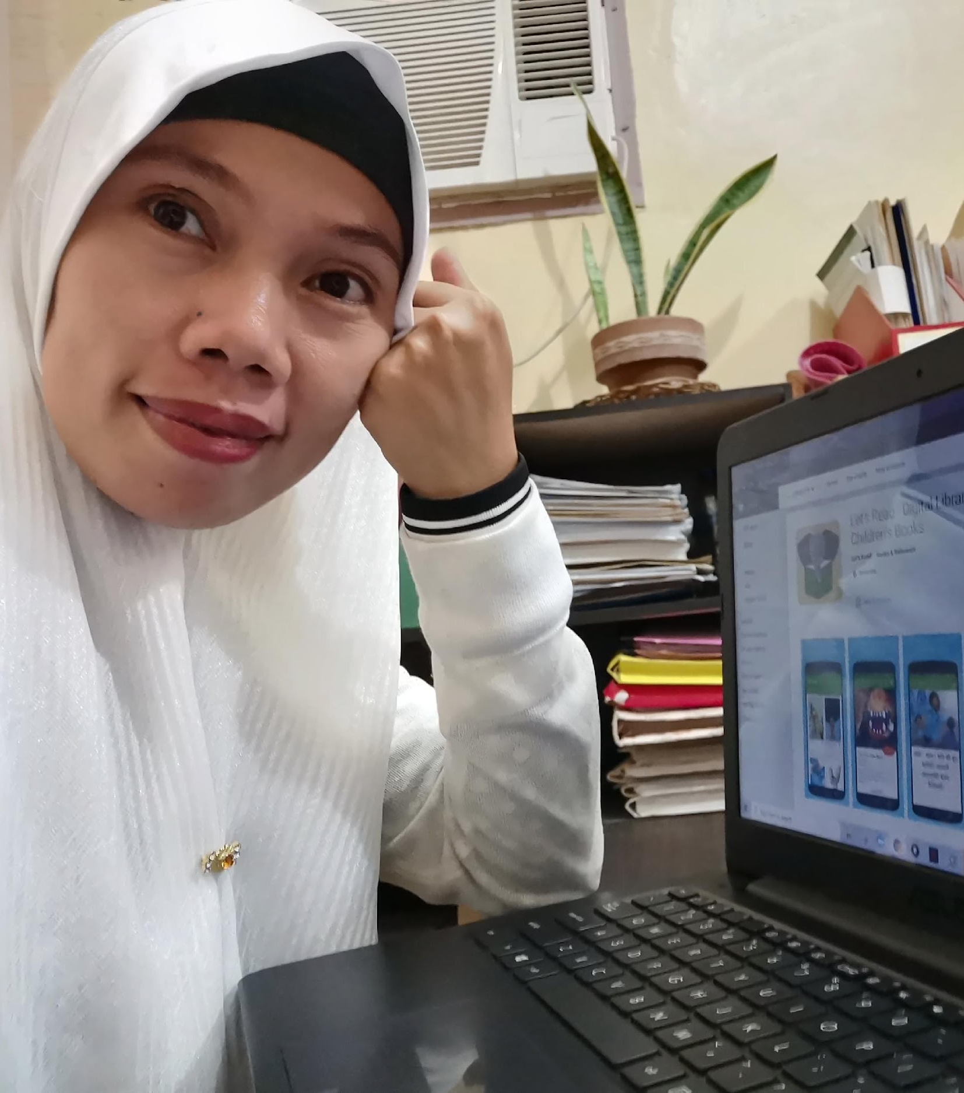




COLLABORATING FOR SUSTAINABLE
TEACHER DEVELOPMENT IN THE EARLY PRIMARY GRADES
Armida Elaine Umali-Trinos, M.Ed
Patience A. Sowa, Ph.D
CIES, April 18th 2022
1
2

Slide 2
INTRODUCTION AND PURPOSE
Description of collaborative process used ensure coherence and alignment of curricular content of preservice teacher preparation and in-service teacher professional development for the ABC+ project.
Notes:
Patience: The purpose of this presentation is to share the collaborative process team members of the ABC+ project went through to ensure coherence and alignment of curricular content of pre-service teacher preparation and in-service teacher professional development. The team members consisted of ABC+ and RTI members who developed the teacher training and FSU members who developed material for faculty professional development.

Slide 3
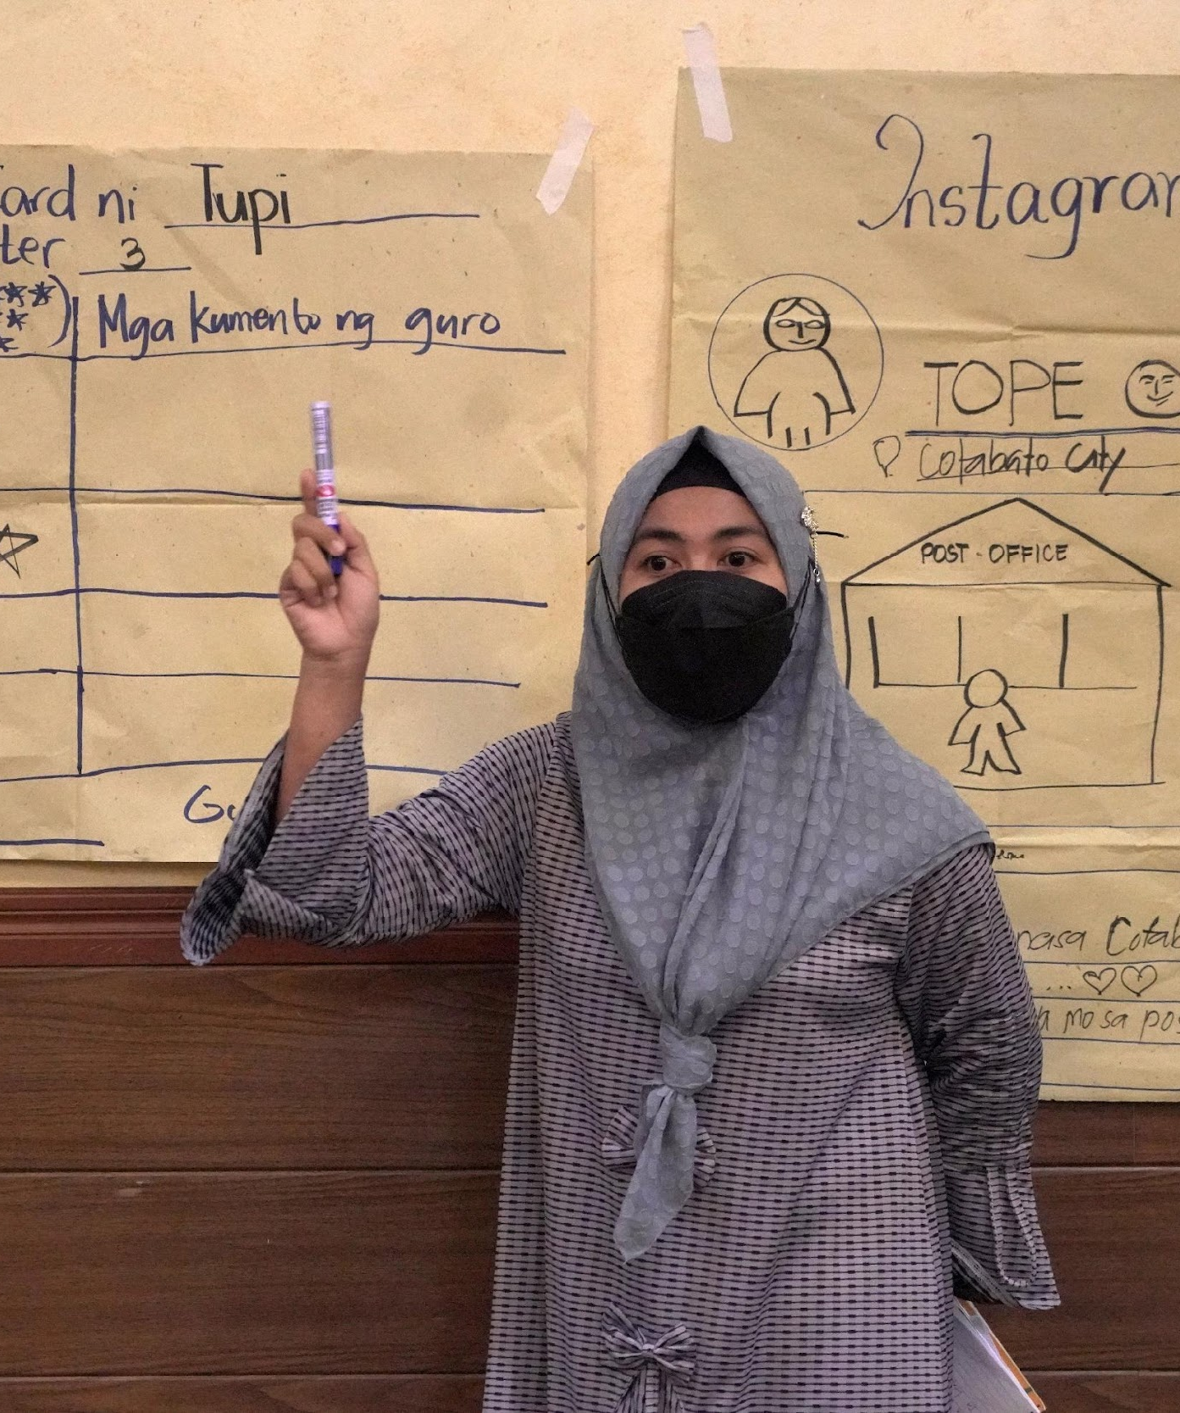
Research Questions
How did the intervention team collaborate to ensure alignment and coherence between preservice teacher preparation and in-service teacher training?
2. What types of curricular content and literacy strategies were aligned for teacher development?
Notes:
Patience: Our research questions were. Use of teacher development to span the continuum of preservice and in-service teacher learning and professional growth.

Slide 4
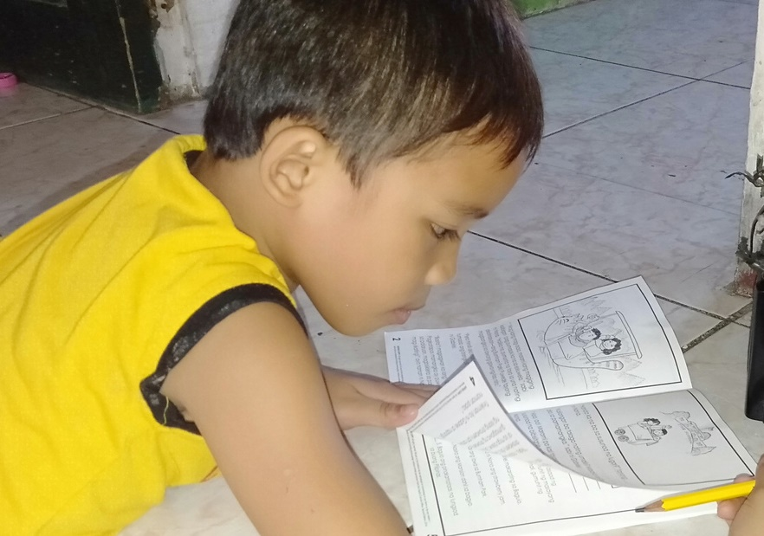
Review of the Literature
Need for coherence and alignment in the development of teacher candidates and in-service teachers (Feiman-Nemser, 2001;McMahon et al. 2015; W.P., 2000; Zuilkowski et al, 2021)
Sustainable teacher development, quality teachers, retention of teachers, and life-long continuum of teacher learning and development (Feiman-Nemser, 2001; Sowa et al; W.P., 2000).
In LMICs inservice teachers PD from implementers, is completely different from curriculum provided to teacher candidates (Zuikowski et al, 2021)
Scant literature on how this alignment and coherence can be achieved.
SDO
Cotabato
logo
Notes:
Patience: Researchers in the Global North and South have long called for the need for teacher development to be aligned and coherent in order to ensure the development of quality teachers, provide sustainable teacher development and retain teachers. They posit that this is essential for life-long teacher learning. This is particularly important in LMICs where frequently the content of in-service professional development funded by donors is completely different from the curriculum that PST take in PSTE programs. There is scant literature on this topic and we hope the presentation of our experiences will add to the body of research, as well as chart a way forward for other projects as they look to align these two points in the teacher development continuum.

Slide 5
Collaborative Model Design
REFLECTION FOR CONTENT ENHANCEMENT
Pause & Reflect sessions
Conversations to enhance content and design
NEEDS ASSESSMENT
Qualitative Review to inform PD design
Survey of In-Service Teachers
Scoping activities with Teacher Education Faculty
Adaptation of basic program development model (Franz et al. 2015).
Steps in collaborative process adapted and modified
Collaborative Process
(Alignment of In-Service and Pre-Service Program)
IMPLEMENTATION
Implementation of In-Service Teacher PD
Implementation in Faculty Development;
Course Implementation for Pre-Service Teachers
ESTABLISHING SHARED GOALS
Defining objectives
Desired outcomes of collaboration
SHARING AND SELECTING CONTENT FOR COHESIVE DESIGN
Sharing of knowledge and work (Check-in meetings)
Selecting high leverage literacy practices
SDO
Cotabato
logo
Notes:
Patience: We adapted and model of basic program development for this study. The design consists of 5 parts. A preliminary needs assessment, the establishment of shared goals, sharing and selecting content for cohesive design, implementation and reflection.
Reference:
Franz, N., Garst, B. A., & Gagnon, R. J. (2015). The Cooperative Extension Program Development Model: Adapting to a Changing Context. Journal of Human Sciences and Extension, 3(2). Retrieved from

Slide 6

Needs Assessment
and Shared Goals
Teacher and Faculty Needs
Bridging and Translanguaging (MTB-MLE)
Phonics
Conducting group work and classroom routines
Oral language development
Effective Feedback
Team: ABC+ Staff, RTI, FSU
Goal
Alignment of in-service and faculty development content and pedagogy
SDO
Cotabato
logo
Notes:
Patience In the first step of the process we conducted a needs assessment of teachers and faculty and used this information to align the content for pre-service and faculty. Needs were bridging, phonics, group work, classroom routines, effective feedback and oral langauge.

Slide 7
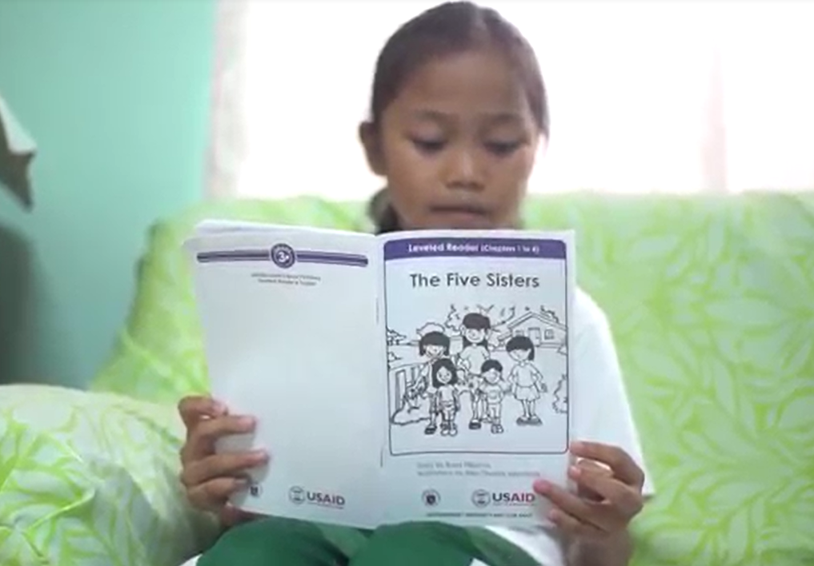
Sharing and Selecting:
Cohesive Design
Alignment to Philippine Education Policies, Competency Frameworks and Standards
Teacher Professional Standards for competency alignment (In-service; Pre-service)
Early Language, Literacy and Numeracy Program for Kindergarten to Grade 3 (ELLN)
Mother Tongue Based-Multilingual Education Policy (MTB-MLE)
Balanced Literacy Approach
Teaching Methods - Direct/ Explicit Instruction
Notes:
Patience : The next step was sharing materials we would need to ensure coherence and alignment. These materials consisted of the Philippine Teacher Professional Standards, DepEd policies, MTB-MLE, Balanced Literacy Instruction, and past teacher professional development (ELLN), and the direct or explicitly instruction methods.

Slide 8
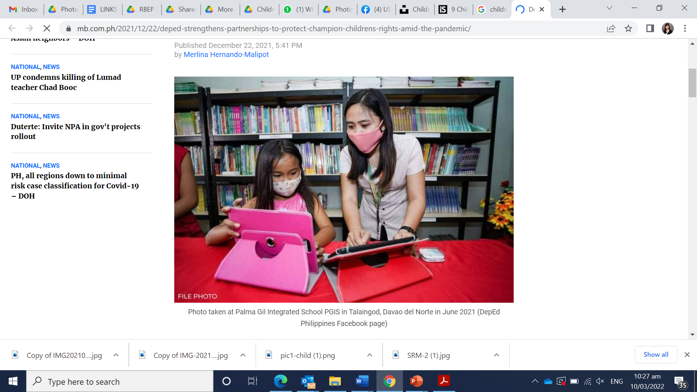
Sharing and Selecting: Cohesive Design
Scoping activities and initial meetings in Manila (PH)
Sharing of TPD and Faculty needs
Initial sharing of teacher training and faculty professional development module outlines
Careful attention paid to teacher professional standards
Shift to remote coordination (during the pandemic: monthly check-in meetings via zoom)
Photo: Manila Bulletin
Notes:
Elaine: The teacher development team had initial face to face meetings in Manila, where they shared needs of teachers and faculty and then outlines and content of the teacher training and faculty development modules. Possible literacy strategies based on teacher and faculty needs were discussed.

Slide 9
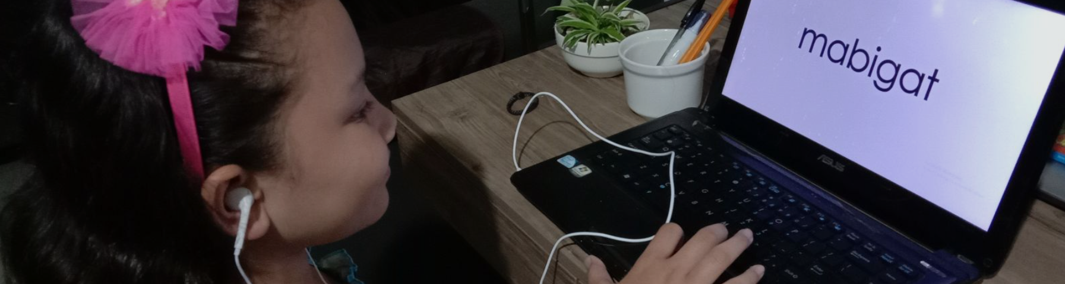
Alignment of Curricular Content and Literacy Strategies
Fostering Social and Emotional Learning (SEL)
Selecting High-leverage teaching practices
Phonological Awareness (Elkonin boxes)
Integrating Gender Equality and Social Inclusion (GESI)
Oral Language Development
(Sketch to Stretch, Language Experience Approach)
Comprehension
(Dialogic Reading)
Notes:
Elaine: This is a selection of some of the agreed upon activities that spanned both content of training for faculty and in-service teachers.
High leverage practices
High leverage teaching practices are instructional tasks and activities that powerfully promote learning and are fundamental to skillful teaching.
They require strong content knowledge for teaching and take up ethical practices and a commitment to equity and diversity.
Garcia, N., & Shaughnessy, M. (2015, October). High-leverage teaching practices: What, why and how. In Ohio Confederation of Teacher Education Organizations Meeting.

Slide 10
Implementation Highlights
Chapters for In-Service training modules and pre-service modules were co-developed with partners, contextualization of content/design
Emphasis on opportunities for practice – hands-on experience of literacy strategies (i.e. scaffolding, demo teaching, microteaching)
Challenges Encountered
Use of early grade reading materials in the MT were limited, due to slow approval process to clear open access
Shift to online/remote learning - pared down literacy strategies, some best done F2F
Teacher trainings adapted and modified for online learning
Access and familiarity to tech platforms were limited; additional training for ICT was embedded
Photo: Manila Bulletin
Notes:
Elaine: Implementation highlights included co-development with partners and ensuring practice of literacy activities. Some of the challenges we encountered included TT and FPD adapted for online learning, less practice. Access and familiarity of teachers and faculty with online platforms. Slow approval process for use of MT supplementary readers, needed for teachers and faculty.

Slide 11
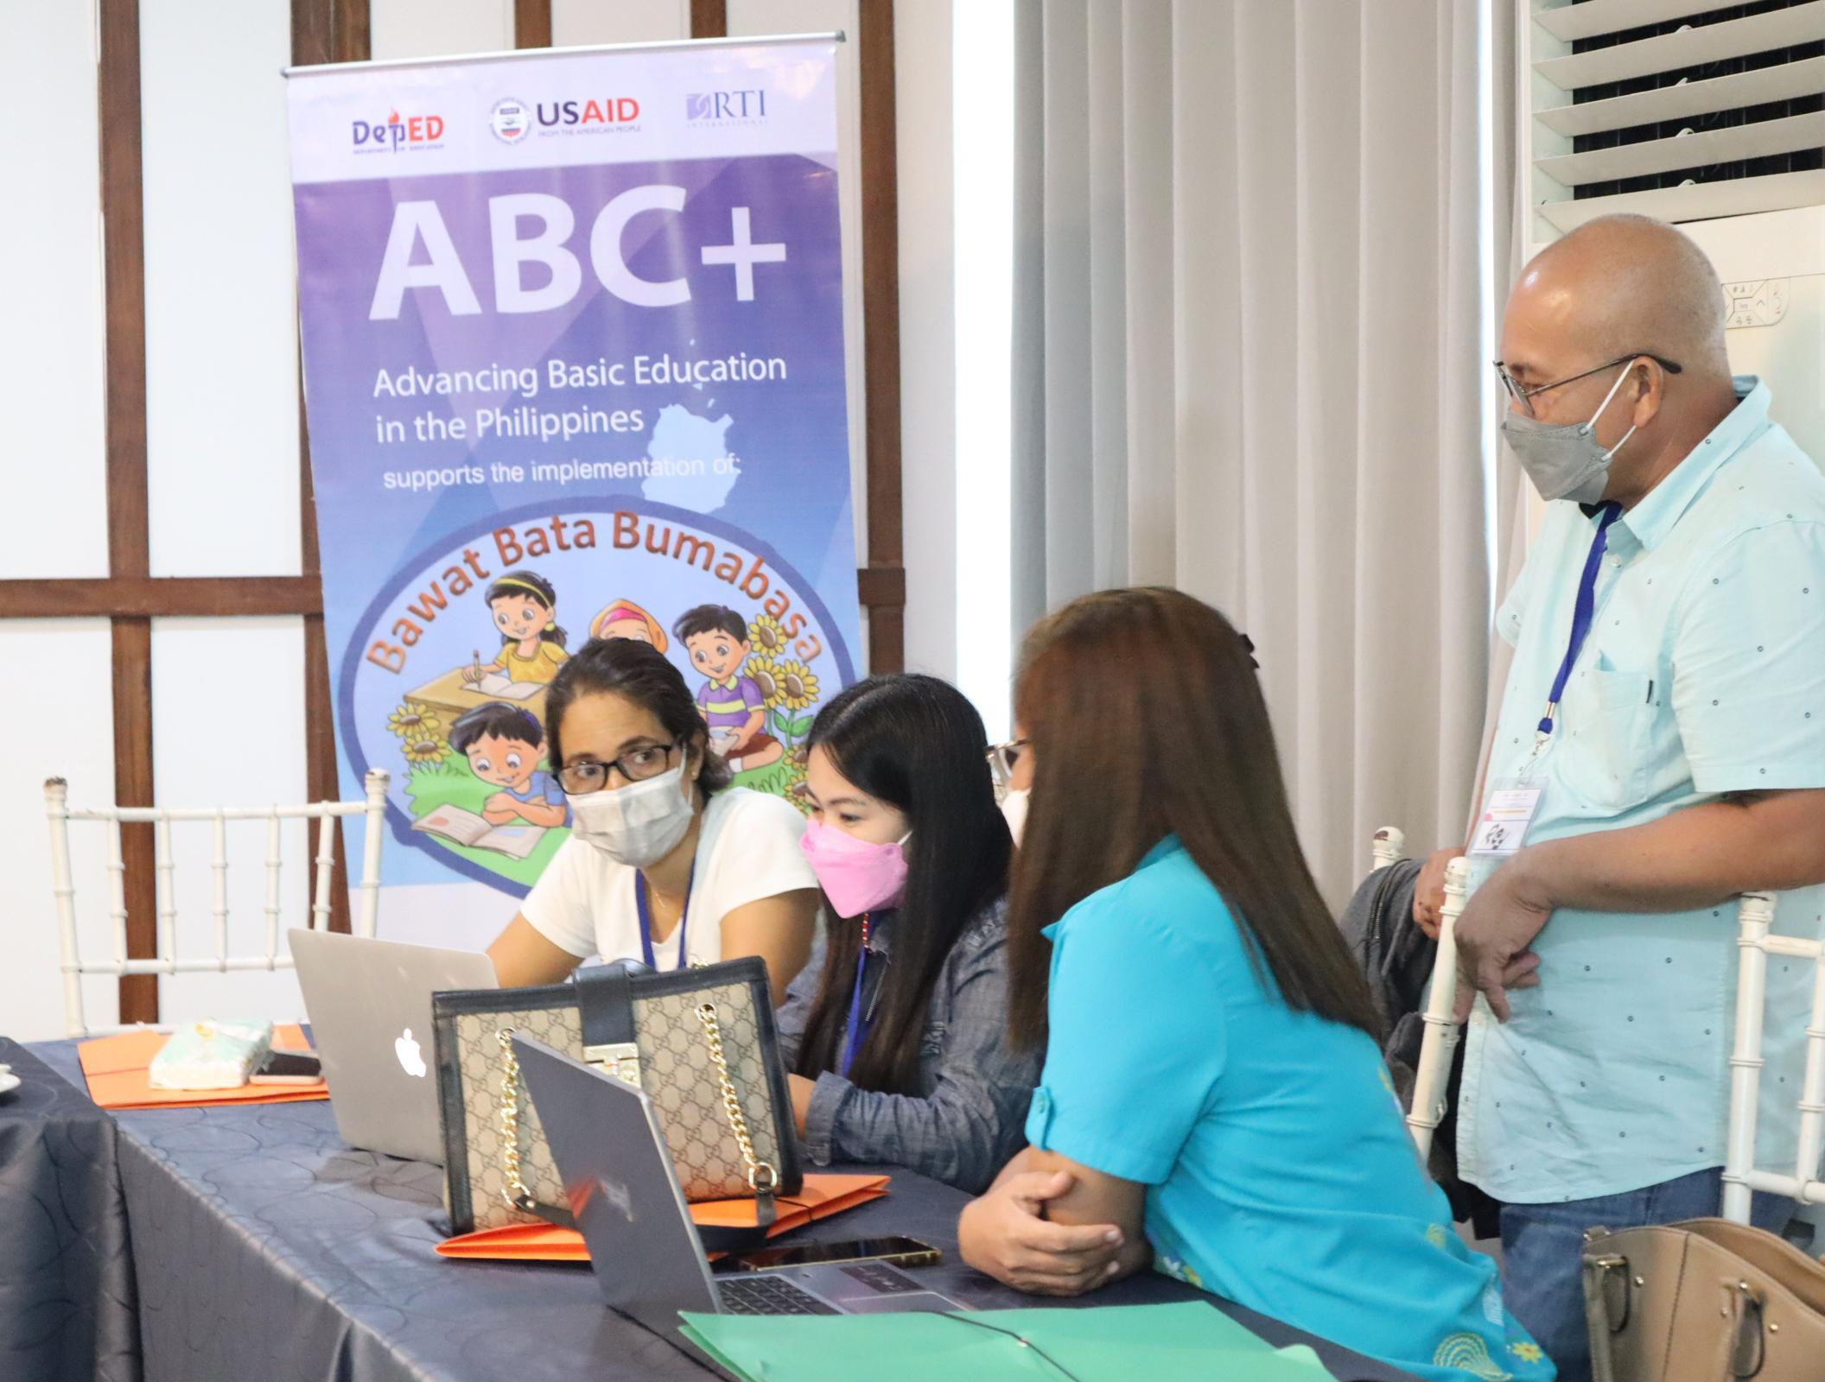
Points of Reflection
Importance of working cohesively provided the ability to reflect and change to improve the process and design
Involvement of educators in the design process (i.e. pre-service faculty, in-service teacher trainers) provided room to contextualize the implementation of learning
Anchoring on existing national initiatives for teacher preparation and continuing teacher PD will pave way to sustain the gains from the interventions
The shared experience between pre-service and in-service work can serve as leverage in establishing Centers for Early Grade Learning (with the partner universities) – potential next step to further sustain the gains in teacher education
SDO
Cotabato
logo
Notes:
Elaine. Collaborative process led to ability to improve and change the process and design. Teacher learning contextualized and anchored in existing national initiatives.

Slide 12

describe teacher professional learning as a long term process extending from teacher education at university to in-service training at the workplace”
Conclusion
To facilitate the development of quality teachers, and the sustainability of evidence-based teaching in schools it is essential to give equal attention to both preservice teacher preparation and in-service teacher training.
It is important to build the initiatives on existing national policies and frameworks to ensure a smoother transition in sustaining the gains in support of teacher preparation.
This is the key to the implementation of early grade literacy interventions which guarantee equitable and inclusive teaching for all children in LMICs.
SDO
Cotabato
logo
Notes:
Patience. Important for policy makers and stakeholders in education, donors and implementers to view teacher professional learning as a long term process extending from teacher education at university to in-service training at the workplace. This will ensure the development of quality teachers leading to sustainable teacher development.

Slide 13



Thank you!

